Slide 2
HPSM Ticket Booking Process

Slide 3
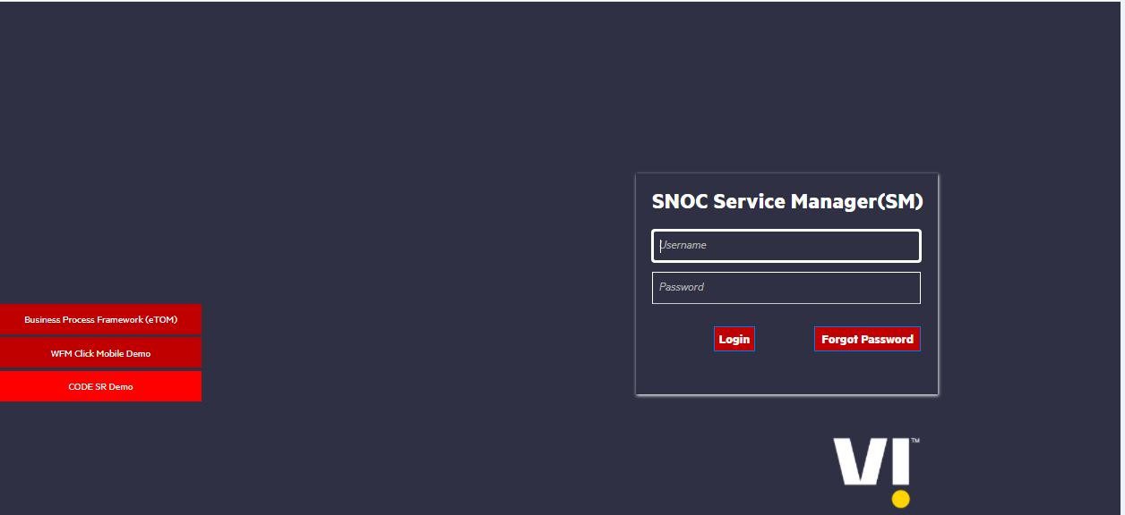
HPSM Login
Step 1: Enter Valid User name and Password and click on Login Tab

Slide 4
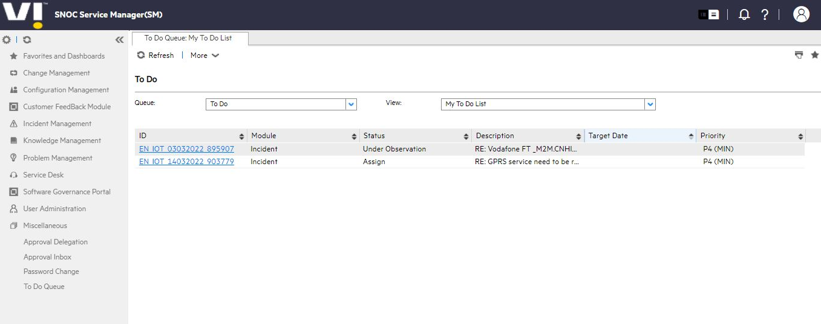
HPSM Home Page

Slide 5
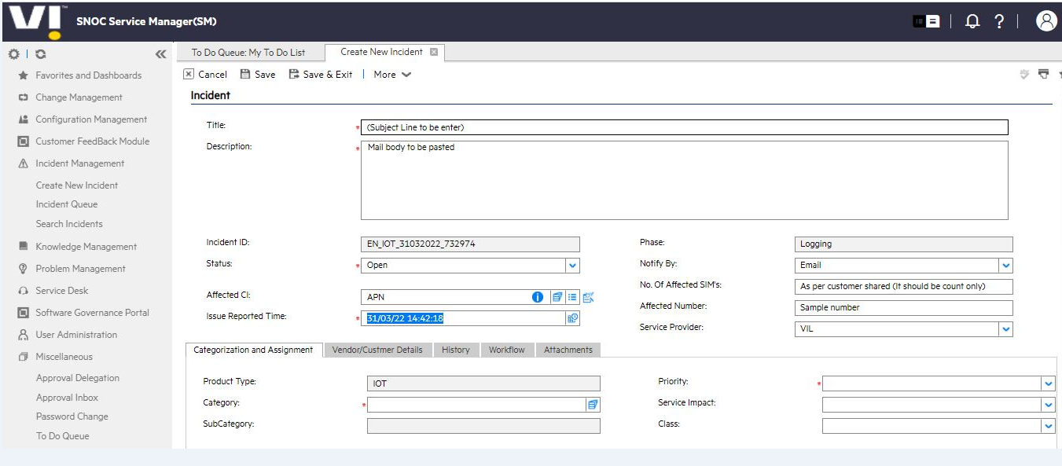
HPSM Home Page
Step 2: Click on Incident management then Create management

Slide 6
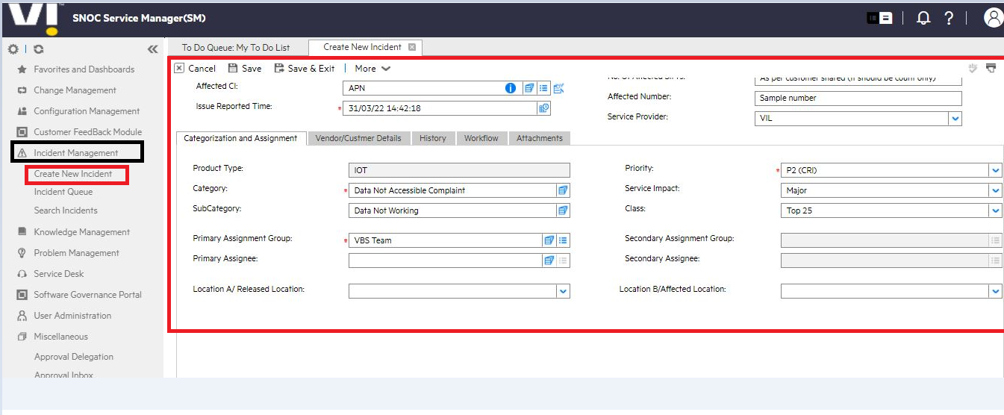
HPSM: Categorization and Assignment
Step 3: Fill the details as per customer issue

Slide 7
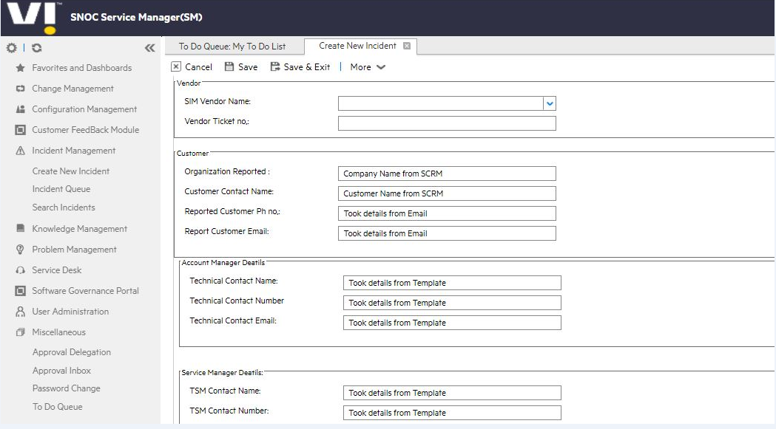
HPSM: Vendor/Customer Details
Step 3: Fill the details as per customer account

Slide 8
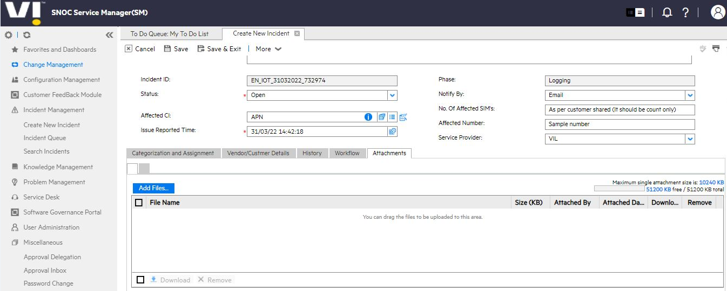
HPSM: Attachments
Step 5: Attach the affected SIMs excel sheet in case of Bulk Numbers issue
Step 6: Click on Save to complete the ticket booking process
Step 7: Share the Incident ID: EN_IOT_31032022_732974 with customer for future reference

Slide 9
Incident Reporting Format
VI IoT/ M2M Issue Reporting (VBS.Customerservice@vodafoneidea.com) -24*7
Toll Free Number:: 55666 or 9920055666
Problem Statement
Issue Start Date
No of SIM Affected (Count)
Affected Sample Numbers (Mobile No/SIM No) (Sample Numbers for Bulk Attach over in Excel File )
Sample Working Number If Any (Optional)
SPOC 1 Name & Contact Number for Troubleshooting/Testing
SPOC 2 Name & Contact Number
Device Level APN
Whitelisted IP/ URL's at device end & Port Numbers
Affected Number Location (Delhi, Mumbai, Bihar, Kolkata Etc.)
Type of SIM (e-SIM/ Standard) Optional
Type of Solution using in device (SMS/2G/3G/4G)
Any recent changes done (whitelisting/ APN change/ barring/ server change etc)
Account Manager Name (Optional)

Slide 10
Severity and Frequency of Updates
Severity | Service Impacts | Frequency of Updates
1 | Total loss of customer service or total failure | 30 min followed by update every 1 hour
2 | Significant impact on customer service | 3 hours
3 | Minor loss of service or intermittent failures | 6 hours
4 | Enquiry with no loss of service or loss of diversity | 12 hours

Slide 11
Escalation Chart for Incidents
Escalation Matrix
Level | Cluster | Availability | Contact Details |  | When
Level 0 | Contact Centre | 24*7*365 | Call 55666 OR 9920055666 and (Option 2 and then key in the 10 or 13 digit IOT number) | Vbs.Customerservice@Vodafoneidea.com | In the first instance please attempt to resolve any issues with the assigned service desk engineer. They have full knowledge of the request and are therefore best placed to deal with any concerns.
Level 1 | North & East | Working Hours Mon-Fri 9:30 AM- 6:30 PM | 7709879515 | imran.shaikh@vodafoneidea.com | For NO response from Level 0. Please allow 4 hours (From incident reporting time & Excluding local contact dependency) for the Level 1 prior engaging level 2. Make sure you have a reference ticket number from VBS Desk.
 | West |  | 7045314235 | Swati.Pawar@vodafoneidea.com
 | South |  | 8411004067 | Shital.Shelar@vodafoneidea.com
Level 2 | All Clusters | Working Hours Mon-Fri 9:30 AM- 6:30 PM | 8411006236 | Chandrakant.Jalke@vodafoneidea.com | For NO response from Level 1. Please allow 8 hours (From incident reporting time & Excluding local contact dependency) for the Level 2.
Level 3 | All Clusters | Working Hours Mon-Fri 9:30 AM- 6:30 PM | 9823006282 | Priyan.koshy@vodafoneidea.com | For NO response from Level 2. Please allow 12 hours (From incident reporting time & Excluding local contact dependency) for the Level 2
Level 4 | All Clusters | Working Hours Mon-Fri 9:30 AM- 6:30 PM | 9823006072 | amartya.sarkar@vodafoneidea.com | For NO response from Level 3. Please allow 24 hours (From incident reporting time & Excluding local contact dependency) for the Level 3
* Make sure you have a ticket number from VBS Desk before engaging Level 1 and above.

Slide 12
Other Support
Whitelisting
Send your request to EBO.iotwhitelisting@vodafoneidea.com via your account manager in proper format. Don’t forget to mention the port number and version. Please connect with your account manager for further details.
Provisioning
All the provisioning request such as Plan changes, APN changes, 4G activation etc. should raise to the account manager.
AAA Mapping
All the AAA IP mapping Work Order request should send to VBS desk via your account manager. TAT is 24 hours for mapping.
GDSP Provisioning
All the GDSP mapping request should send to VBS desk via your account manager. TAT is 24 hours for provisioning

Slide 13
CRM Prechecks and Understanding and IoT use cases

Slide 14
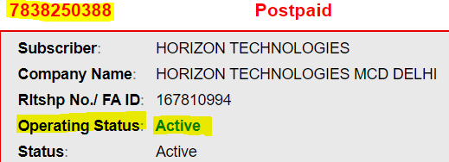
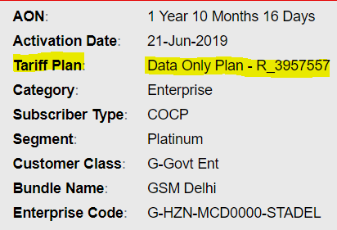
SCRM Checks
Punch number in CRM check the status of the number in Dashboard, check Tariff plan, APN name, National roaming, SMS MO MT services
Operating Status: Active
If Operating Status is inactive, inform the Stakeholders and close the ticket.
Tariff Plan
If Tariff Plan is non-IOT, inform the Stakeholders and close the ticket

Slide 15
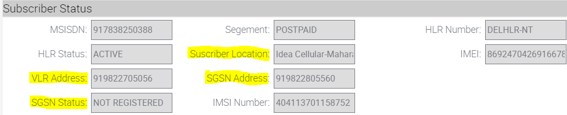
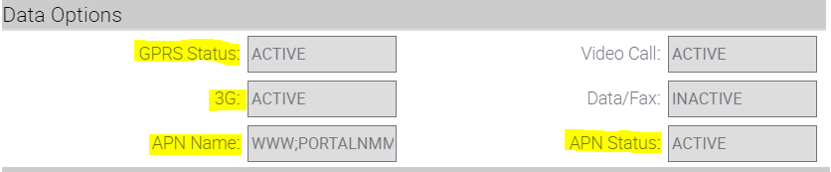
SCRM Checks
HLR Status
If HLR Status is inactive, inform the Stakeholders and close the ticket
APN Name
If APN Status is inactive, inform the Stakeholders and close the ticket.

Slide 16
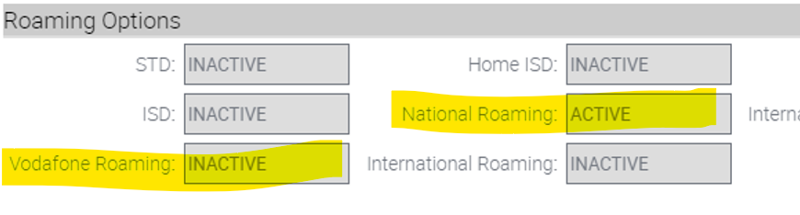
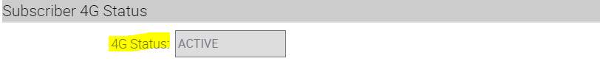
SCRM Checks
National Roaming
If Roaming is inactive, inform the Stakeholders and close the ticket.
GPRS Status & 4G (If Provided)
If GPRS is inactive, inform the Stakeholders and close the ticket.

Slide 17
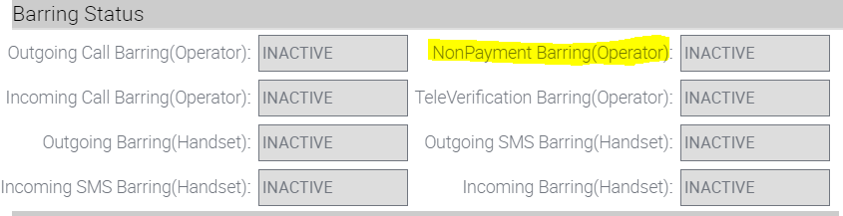
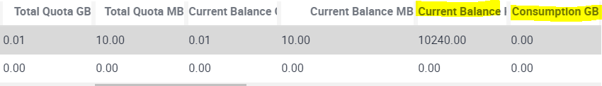
SCRM Checks
Barring
If Barring is active, inform the Stakeholders and close the ticket
Data Balance

Slide 18
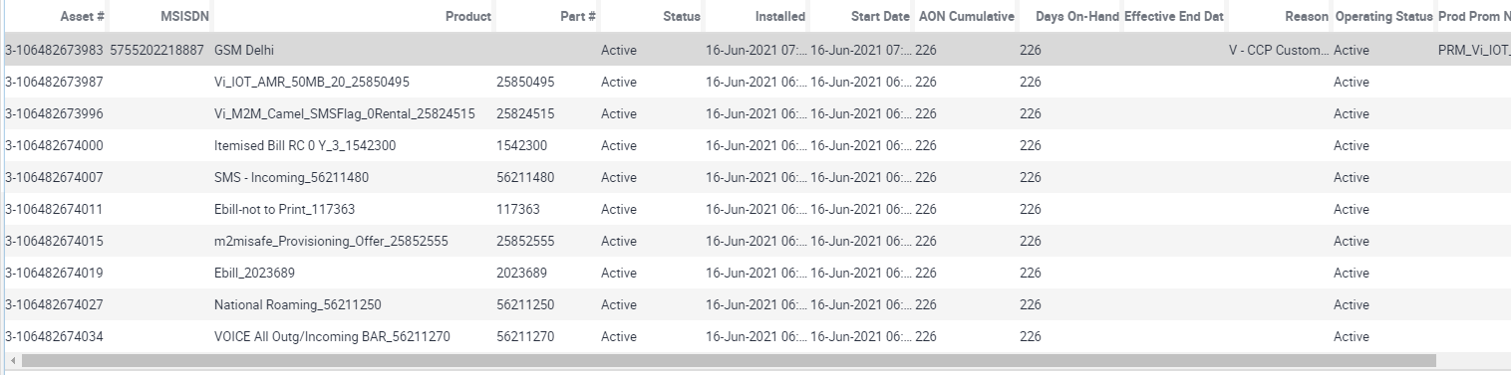
SCRM Checks
Sub-Components
Check for any recent activities which leads to the outage.
Device Level APN
From the incident reporting form shared by the customer, confirm that the APN configured in the device is same as configured in SCRM

Slide 19
Use Case | Org Name | Solution | Solution Document
VTS | S-WHEELS55134-3OTHER | VTS solutions are widely used for vehicle tracking via GPS where enterprises have connectivity established with their server via M2M SIMs. Where they used to track location, battery status, etc. | Attached
 | C-SENSORISE00-SENSOR |  | Attached
POS | C-LYRANETWORK-LYRANE | POS are point of sale devices where customer whitelist their server Ips via M2M SIMs and used for the payment at merchants. | Attached
 | C-ONE97COMMUN-000000 |  | Attached
AMR | G-ENERGYEFFIC-STADEL | Automated metering solution (AMS) offers an effective turnaround for such enterprises by deploying smart meters that can read, monitor, and alert utility companies remotely via M2M SIMs. | Attached
 | C-TORRENTPOWE-000000 |  | Attached
Connected Car | V-HYUNDAIMOTO-HYUNDA | A connected car solutions are used to interact with another smart devices/web on the internet via M2M SIM. And share the info like - vehicle location, speed, acceleration, fuel efficiency, engine performance, SOS, and other operational parameters. | Attached
 | V-MARUINUDYOG-SUZUKI |  | Attached
Sound Box | C-PHONEPEPRIV-FLPKRT | soundbox is an audio assisted smart device which provides instant notifications when you receive a payment. The payment alerts which come with a M2M SIM based connectivity. | Attached

Slide 20
Thank you !

